Slide 1
Healthy Marriage Tips?
George Ding

Slide 2
First thing I noticed…
Before we start building our actual prediction method, I wanted to look at some of the quirks at the three marriage statuses, so I broke them down into each individual subsets.
Already I noticed something incredibly off put with the married Subset.

Slide 3
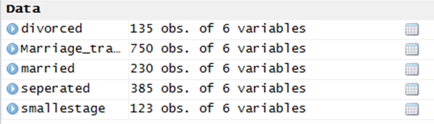
Married Couples
First thing I noticed in this subset, comparing this to the other two, was the small difference in age all of these couple had. This was ironic considering the amount of variables each of these subsets had:

Slide 4
Digging a bit deeper
By eventual trial and error, I found out that the largest gap between these married couples wouldn’t go over the age gap by 9. Comparing this to the other two groups, where they had age gaps over 40. There had to be a link in this.
Code:
>smallestage <- subset(married, married$GroomAge - married$BrideAge >= 9 | married$GroomAge - married$BrideAge <=-9)
> smallestage <- subset(seperated, seperated$GroomAge - seperated$BrideAge >= 40 | seperated$GroomAge - seperated$BrideAge <=-40)

Slide 5
So I tried to find the uncorrelated variables…
Code:
> rpart.tree <- rpart(STATUS ~ GroomAge+BrideAge+GroomPersonality+BridePersonality+Joint Income, data = Marriage_training)
> predict.tree <- predict(rpart.tree, newdata = Marriage_training, type = "class")
> eroor <- Marriage_training$STATUS
> error.tree <- mean(predict.tree != eroor)
> error.tree
[1] 0.296
> rpart.tree <- rpart(STATUS ~ GroomAge+BrideAge+GroomPersonality+BridePersonality, data = Marriage_training)
> predict.tree <- predict(rpart.tree, newdata = Marriage_training, type = "class")
> eroor <- Marriage_training$STATUS
> error.tree <- mean(predict.tree != eroor)
> error.tree
[1] 0.2146667

Slide 6
Cont…
Code:
> rpart.tree <- rpart(STATUS ~ GroomAge+BrideAge+GroomPersonality, data = Marriage_training)
> predict.tree <- predict(rpart.tree, newdata = Marriage_training, type = "class")
> eroor <- Marriage_training$STATUS
> error.tree <- mean(predict.tree != eroor)
> error.tree
[1] 0.4866667
> rpart.tree <- rpart(STATUS ~ GroomAge+BrideAge, data = Marriage_training)
> predict.tree <- predict(rpart.tree, newdata = Marriage_training, type = "class")
> eroor <- Marriage_training$STATUS
> error.tree <- mean(predict.tree != eroor)
> error.tree
[1] 0.4866667
> rpart.tree <- rpart(STATUS ~ GroomPersonality+BridePersonality, data = Marriage_training)
> predict.tree <- predict(rpart.tree, newdata = Marriage_training, type = "class")
> eroor <- Marriage_training$STATUS
> error.tree <- mean(predict.tree != eroor)
> error.tree
[1] 0.18

Slide 7
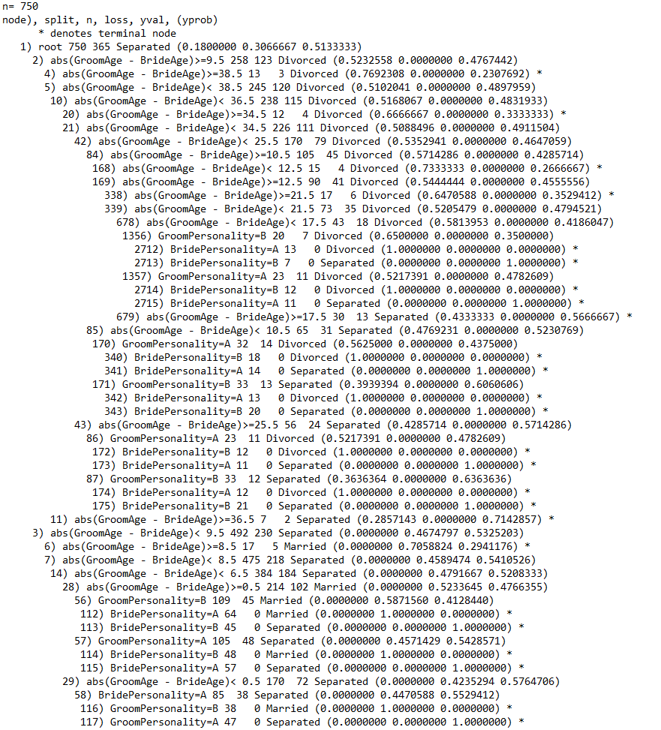
R tree:

Slide 8
Weird Findings?
Without any contain methods, the R machine has seemed to deemed Joint Income useless, but also to have a smaller error base when we leave out the Bride and Groom’s age. This can’t be right.
Instead, lets build a new column, one of the difference of their ages.
Code:
> Marriage_training[,7] <- ""
> colnames(Marriage_training)[7] <- "AgeDifference"
> Marriage_training[,7] = abs(Marriage_training$GroomAge - Marriage_training$BrideAge)

Slide 9
Lets see if this new column helps:
Code:
> rpart.tree <- rpart(STATUS ~ GroomPersonality + BridePersonality + AgeDifference, data = Marriage_training)
> predict.tree <- predict(rpart.tree,newdata = Marriage_training, type = "class")
> eroor <- Marriage_training$STATUS
> error.tree <- mean(predict.tree != eroor)
> error.tree
[1] 0.04933333
Analysis? Oh yeah. Lets move onto CrossValidation now

Slide 10
Cross Validation, before actual submitting:
Cross Validation is very simple, just follow the code and it’ll print out two different predictor accuracies, one on the subset itself, and an actual subset.
Code:
> rpart.tree <- rpart(STATUS ~ GroomPersonality + BridePersonality + abs(GroomAge - BrideAge), control = rpart.control(minisplit = 2), data = Marriage_training)
> CrossValidation::cross_validate(Marriage_training, rpart.tree, 2, .8)
accuracy_subset accuracy_all
1 0.8800000 0.5933333
2 0.6533333 0.7066667

Slide 11
And now we submit:
Code:
> library("rpart")
> rpart.tree <- rpart(STATUS ~ GroomPersonality + BridePersonality + abs(GroomAge - BrideAge), control = rpart.control(minisplit = 2), data = Marriage_training)
> predict.tree <- predict(rpart.tree,newdata = Marriage_training, type = "class")
> predict.tree <- predict(rpart.tree,newdata = Marriage_testing_students, type = "class")
> submission <- Marriage_testing_students
> submission$STATUS = ""
> submission$STATUS <- predict.tree
> write.csv(submission, 'submission.csv', row.names= FALSE)

